Slide 1
Doing Business in Antwerp
WTC Leeuwarden Webinar
19 november 2020
Spreker : Fred Niemans
President WTC Antwerp
Senior Partner Dilaw Greenfield
(Fred@Greenfield-law.eu)

Slide 2
THE CITY OF ANTWERP
The best cities in the world are founded with a myth, and Antwerp is no exception.
The legend has it that, to cross the river Scheldt, you first had to pay a toll to a fearsome giant named Antigoon
Of course a hero was needed, and he arrived in the form of a Roman soldier named Silvius Brabo.
Brabo slayed the giant (Antigoon), cut off its hand, and tossed it into the River Scheldt.
And given that the Dutch for 'hand thrown' is 'hand werpen', a city's name was born.

Slide 3
Antwerp is well known for its :
Gentle and well educated people (University of Antwerp)
Port of Antwerp
2nd largest port in Europe
Gate to the world // to Europe
Diamond(s)
Second largest centre of diamonds in the world (New York/Dubai)
Fashion
International Fashion Academy
Famous Designers
Night Live
A large variety of restaurants and bars
Near the centre (range 500 meters) 10 restaurants with 4 or 5 stars
Chocolate and beer

Slide 4
Why doing business in Antwerp ?
Location
Antwerp is the Business capital or centre of Flanders / Belgium
Education
University of Antwerp
Fashion Academy
Antwerp =
BIG
SMALL
Antwerp = easy to reach
Train
Car
Plane
Airport (Deurne International airport)
Heliport
Centre of Europe
50 km from Brussels (European Community)
120 km van Amsterdam
400 km van Paris

Slide 5
Port of Antwerp
Port of Antwerp
2nd largest Port in Europe
Gate to the world
Near Rotterdam
Our Values
Trust
Passion
Guts
Simplicity
Connection
Gate to the world
Gate to the rest of Europe
Connections
The Beacon : hotbed for creative minds and innovation ideas
NxtPort : making exchange of data between the various players faster
PortXL : a start-up accelerator using mentors in the port of Antwerp
https://youtu.be/JTbUQYINNEU?t=17
https://youtu.be/6dEImO6oClQ?t=4

Slide 6
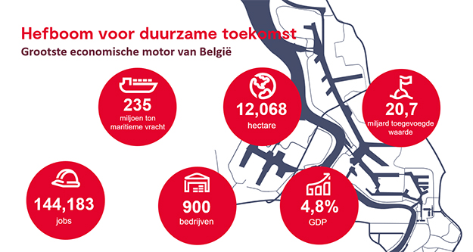
Port in figures

Slide 7
DIAMONDS
2nd biggest centre of Diamonds in the World
Tradition
Jewellery
Trade
Jewellery
Control on the quality
Networking and useful contacts
Support in finding trustworthy business partners to get you business going
Sharing knowledge and best local practises
Connections
https://visitantwerpen.maglr.com/antwerp-diamond-capital-since-1447-editie-2019/antwerp-diamond-capital-since-1447

Slide 8
FASHION
FASHION ACADEMY
Fashion museum
Modenatie
International Academy
More then 40 different nationalities
Very good reputation
Fashion Show (every year 6.000 spectators)
SHOPPING
High end fashion brands
Local stores (Boutiques)
DESINGERS
Dries Van Noten, AF Vandevorst,
The 7 off Antwerp
Connections
https://www.facebook.com/126178190794047/videos/564786960719338

Slide 9
Night live
Restaurants
A large variety of restaurants and bars
Near the centre (range 500 meters) 10 restaurants with 4 or 5 stars
Chocolate and beer
Hotels
Bars
Chocolate and Beers
Connections
https://www.beertourism.com/blogs/city-guides/antwerp
https://www.chocolatenation.be/sites/default/files/videos/trailer-chocolatenation.mp4

Slide 10
WTC Antwerp
WTC Academy
Information sessions on an actual subject
40 participants
Every moth (evening)
MEET UP AT LUNCH
Lunch with a key note speaker
Maximum 50 participant
4 Times a year
WTC Today
Magazine every two months
NEWYEAR – CHRISTMAS
Christmas and New years drink
Network event (200 participants)
SUMMER RECEPTION
Network event (200 participants)
CAPTAIN’S TABLE

Slide 11
WTC Antwerp
Offices
Start-ups
Scale- ups
Short term – long term / rent offices
Meeting rooms (10 – 200 participants / high end facilities)
Location
Lindner Hotel (12th floor)
Centre of Antwerpen
Walking distance from the Railway station
(12th floor) 360° view over the city Antwerp
Contact
WorldTrade Center Antwerp
Lindner WTC Hotel & City Lounge Antwerp
(Kievitplein)
Lange Kiievitstraat 125
2000 Antwerpen
Tel : +32 03 227 77 00
www,wtcantwerp.be
- Fred Niemans fred.niemans@wtcantwerp.be
- Peter Nuiten peter.nuiten@wtcantwerp.be
- Patrick Moens patrick.moens@wtcantwerp.be
- Jean-Paul Christiaens jean-paul.christiaens@wtcantwerp.be

