Slide 1
The Netherlands - Russia Centre
We are for erasing boundaries
and opening new opportunities
Johan Elzes – General manager NRCE Russia

Slide 2
Our focus
NRCE​
​The Netherlands - Russia Centre
The Netherlands-Russia Centre aims to build business, governmental and cultural relationships between the Netherlands and Russia.
Business Consulting
Cultural Cooperation

Slide 3
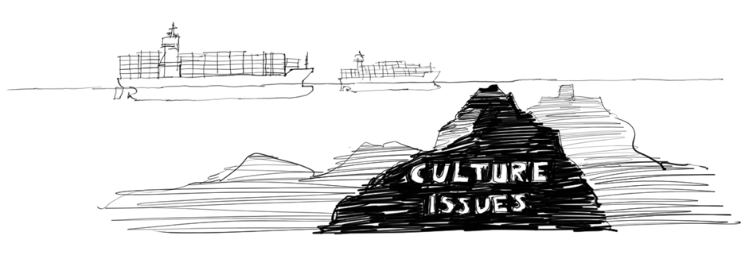
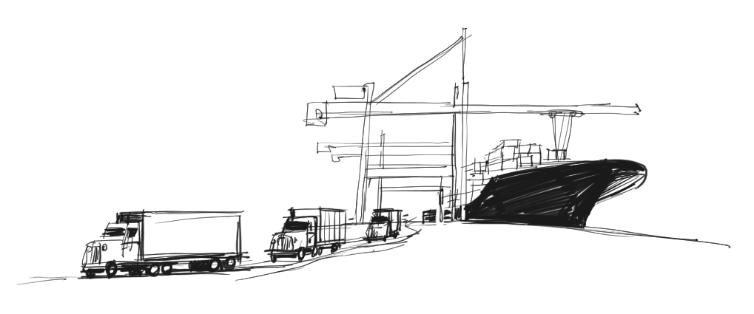
Cultural differences
NRCE​
​The Netherlands - Russia Centre
Understanding = respect

Slide 4
Cultural differences NL – RF
NRCE​
​The Netherlands - Russia Centre
Dimension 1: Communication
US
NL
RF
Low context
Dimension 2: Evaluating
High context
RF
NL
US
Direct negative feedback
Indirect negative feedback
Dimension 3: Leading
NL
US
RF
Egalitarian
Dimension 4: Deciding
Hierarchical
NL
US
RF
Consensual
Top-down
Dimension 5: Trusting
US
NL
RF
Task-Based
Dimension 6: Disagreeing
Relationship based
RF
NL
US
Confrontational
Avoids confrontation
US
Dimension 7: Scheduling
NL
RF
Linear time
Flexible time
Dimension 8: Persuading
RF
NL
US
Applications first
Principles first

Slide 5
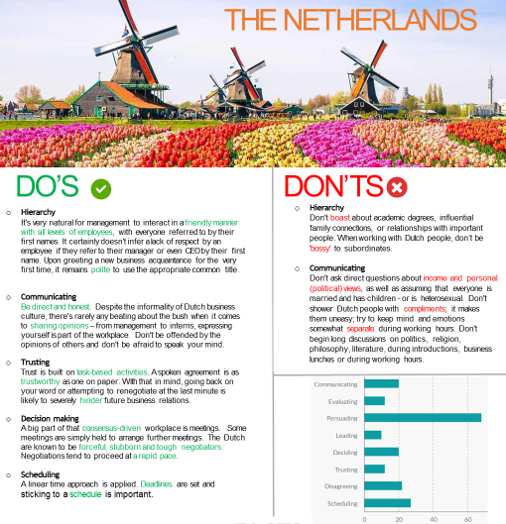

Slide 6
Thank you for your attention
Johan Elzes
General Manager NRCE Russia
j.elzes@nrce.nl
+7 921 44 27085
NRCE​
​The Netherlands - Russia Centre

